Slide 1
Module 1 Data Warehouse Concepts and Architectures
Lesson 4: Learning effects for data warehouse development
Notes:
Welcome to Lesson 4 of Module 1 on Data warehouse concepts and architectures
Previous lesson:
Historical reasons for development of data warehouses
Basic terminology
Comparison between data warehouses and operational databases
Opening question:
- What part of a skill learning curve corresponds to the common phrase “steep learning curve”
In answer to the opening question, steep learning curve is a misleading term. When this term is used, most people mean a skill in which a high fixed amount of effort is needed to master a skill. This high fixed amount of effort makes a skill difficult to learn as many individuals will not make the effort to master the skill. In the skill learning curve, a steep learning curve indicates a long, slow initial learning period. The second part of the graph showing the acceleration is not impacted by the initial period so the word “steep” is misleading as typically used.

Slide 2
Lesson Objectives
Discuss challenges in data warehouse projects
Explain learning effects for maturity and project management
Reflect on importance of intangible benefits for data warehouse investments
Notes:
Unique challenges in data warehouse projects
Learning effects: slow start, accelerated change, plateau
Intangible benefits are difficult to measure and predict

Slide 3
Challenges in Data Warehouse Projects
Substantial coordination across organizational units
Uncertain data quality in data sources
Difficult to scale data warehouse
Notes:
Project scope:
- Difficult because of the amount of coordination: units not used to coordinating
- Difficult to estimate the effort (cost, time) partially due to uncertain data quality
- Difficult to build a scalable data warehouse: often grow much larger than anticipated

Slide 4
Intangible Benefits
Not easily quantified but important for an organization’s success
Increased data quality
Fewer missing values
More matched entities
More data availability
Higher levels of compliance with data standards
May become tangible over time
Notes:
Intangible benefits: difficult to measure market value
Intangible benefits typically include brand recognition, employee expertise, and management skill
Intangible benefits for a data warehouse may involve increased data quality (improvements in standardization, fewer missing values, larger number of matched customers across business processes, more data available, …)

Slide 5
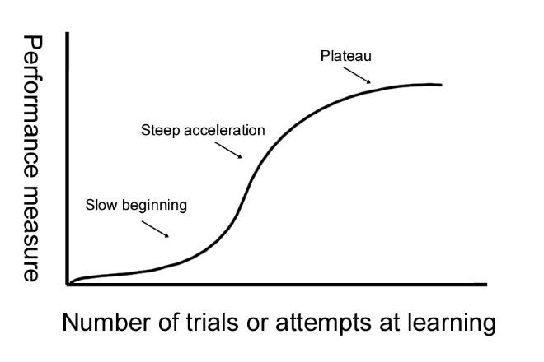
Learning Curve for Skills
Notes:
From: http://www.intropsych.com/ch07_cognition/learning_curve.html (Dr. Dewey)
Skill mastery learning curve
X axis: number of trials
Y axis: performance
Implied fixed cost (master skills) to improve performance
Sports skill improvement such as first serve percentage
Slow beginning as high fixed cost (many trials) to acquire skills
Steep acceleration as skills are mastered
Plateau as diminishing returns from additional trials
Lesson:
Expect many trials over a long period to obtain reasonable improvement in skills
Initial learning period may be frustrating
Rapid improvement and enjoyment from skill mastery after initial period of frustration

Slide 6
Learning Curve for Production
Notes:
Production learning curve
Applies to industries such as aircraft manufacturing
Switch axis: units produced on x axis and effort (average work hours or cost)
Implied fixed cost to discover and resolve production problems
Slow beginning as problems are discovered
Steep deceleration as production problems are resolved
Plateau as constant cost to resolve data quality problems
Lesson
Expect high costs to improve production capability (productivity)
Productivity improvements occur rapidly after initial period with sharply falling costs

Slide 7
Maturity Relationships
Notes:
Scope learning curve
Skill learning curve with initial slow learning, steep acceleration, and plateau
Business value over time
Fix scope: number of data sources or organizational units
Business value may be measured by usage (number of users, departments, queries)
High fixed cost to discover data sources and find uses especially for combining data sources
Initial slow usage of data sources
Rapid acceleration as new uses are discovered
If DW project is too small, benefits of scope may never be realized.
Data transformation learning curve
Production learning curve
Fix scope: number of data sources or organizational units
High fixed cost to discover and resolve data quality problems
Slow beginning as data quality problems are discovered
Steep deceleration as data quality problems are resolved
Plateau as constant cost to resolve data quality problems
Transformation cost over time
Cost to clean, standardize, and integrate
Large initial cost to discover data quality problems
Rapid improvement as data quality problems are resolved

Slide 8
Project Relationships
Notes:
Skill learning curve analogy
X axis: scope
Number of data sources
Number of organizational units
Y axis: business value
ROI
Number of users
Decision making efficiency
Scope to Business value
Scope increases
Business value increases with a learning effect
Business value will lag project costs and risks
Scope to Risk
Scope increases
Risk increases due to coordination difficulties
Initial flat curve, then sharp increase in costs, with a plateau
Risk mitigation: gradual warehouse scope widening; anticipate difficulties
Insight
Tradeoff between risk and scope
Reduced scope has less project risk, but benefits of large scope may never be realized if many small projects without a plan to create a DW with a larger scope.

Slide 9
Summary
Project difficulties and intangible business value
Learning curves for skills and production
Learning curves for maturity and project scope
Notes:
Project difficulties:
Intangible benefits
Large amounts of coordination with business areas that may never have coordinated much
High risk with large initial projects

